Slide 1

Robot dressing support system(RDSS)
Shelvin Pauly 118426556
Prasanna Thirukudanthai Raghavan 118287546

Slide 2
Introduction
This project aims to simulate an assistive robot with dressing capabilities. In this presentation, we have provided a brief of explanation of
Motivation
Application
Work Done
Calculations
Problems Faced
Conclusion
References

Slide 3
motivation
The ongoing pandemic
According to the UK journal of Occupational & Environmental Medicine, healthcare workers are 7 times as likely to have severe COVID-19 infection compared to people in other professions.
Pressure on caregivers
As per WHO, the world’s population of people over 60 years is anticipated to double by 2050 compared to 2000.
Specially-abled
CDC points out that 13.7% of the population in US has disability in mobility.
Research
The field of robotics is at its peak and there is numerous possibilities in every application, especially when we all are going facing these tough times(pandemic), we should try and augment our health sector.

Slide 4
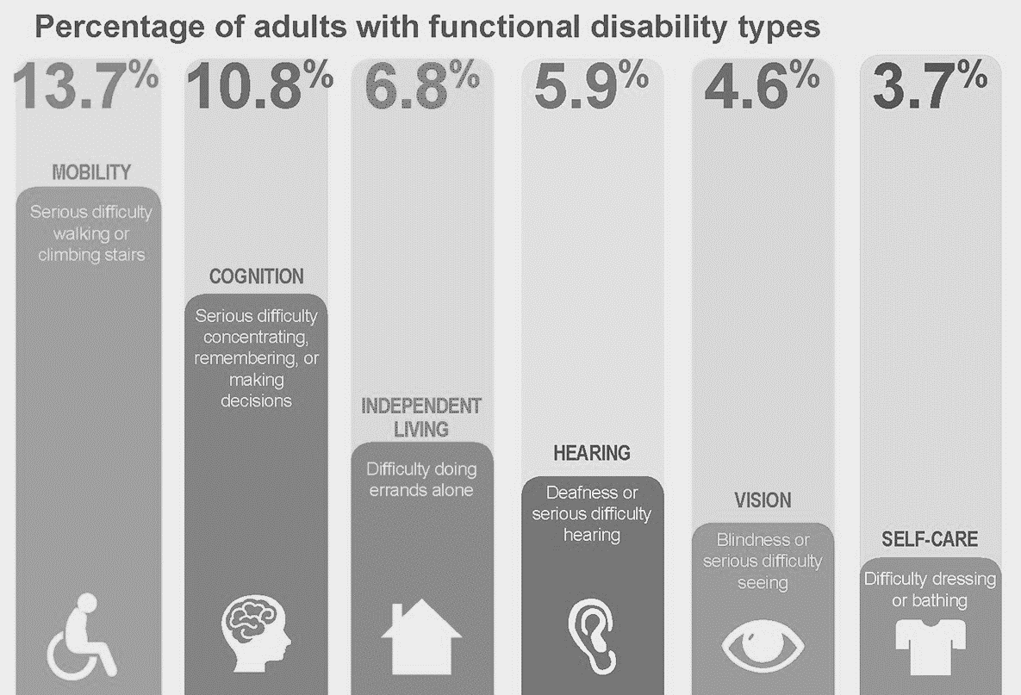
Application
Caregiving Industry
The Industry lacks the influx of technology of in this specific assistive technology. Such systems can provide help with dressing people with functional disabilities as well.
Sense of Independence
The people with this disabilities are highly dependent on their caregivers. Using such systems, they will be able to gain a sense of independence.

Slide 5
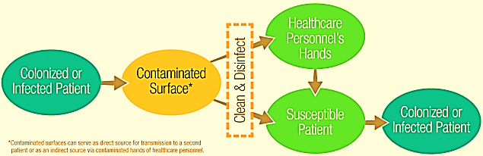
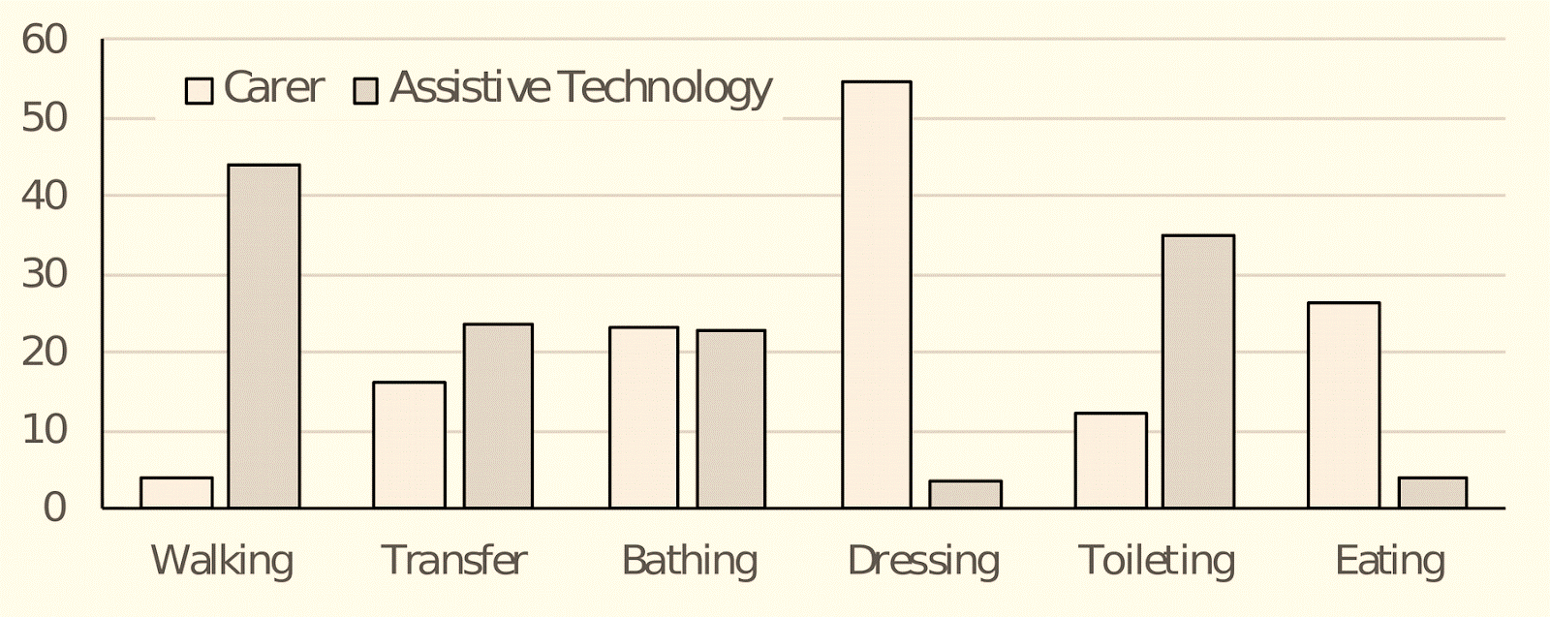
Application
CONTAMINATION
NEED FOR AUTOMATION
Transmission of pathogens by contamination from high-risk health case provider’s apparel like (PPE kits, etc.)
Even though dressing is the most burdensome caregiving activity, it uses the least amount of technology and thus, arises the need for research is this field.

Slide 6
Work done
Research
CAD Modelling
URDF
Controllers
PID Tuning
Publisher/Subscriber
Teleop
Visualization

Slide 7
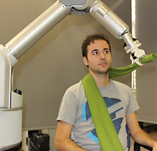
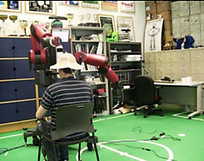
Research
Our research made us realize that this specific application is an ongoing research which is being spear headed by Institut de Robòtica i Informàtica Industrial, Barcelona and Bristol robotics laboratory. Multiple advanced methods like robot learning, motion modelling, simulation-based motion optimization, and Human Robot Interaction also need to be applied to make the project ideal to use in real life scenarios. Much emphasis needs to be made in the field where the robot can identify different types of cloth materials, human behavior, etc. to make it fully autonomous, which remains to be the final goal.

Slide 8
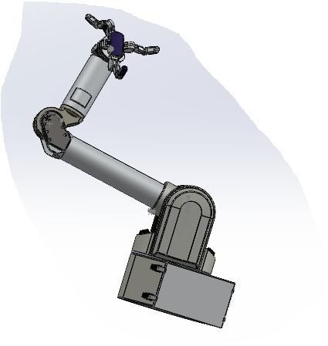
CAD Modelling
The model was available on the product page for Barrett Technologies.
However, that model was not compatible for our use. So, we had to rotate each part according to the coordinate system in Gazebo, reassemble the assembly with a coordinate system explicitly mentioned for the base link of the robot before exporting it.
Remark : Part Assembly is an art

Slide 9
URDF, Controllers And PID Tuning
The URDF file required a lot of manual tuning for multiple tags. The masses of each link were inconsistent and caused the model to behave in an undesirable way. So, the masses and their respective moments were changed.
The joint limits were mentioned explicitly.
URDF also consists of the transmission blocks for all joints with motion.
However, xacros were also used to integrate the gazebo_ros_control.
The launch file included both the xacro and the URDF for everything to work in symphony.
In an ideal case, effort controllers are used for such manipulators, but we were unable to implement them, so our specific model uses velocity controller to do the task.
The PID values were tuned manually with help of a graphical ros tool(rqt_gui). We published a sinusoidal value that oscillates the joint and then monitored the actual position of the joint and then making sure the joint follows the value properly

Slide 10
Teleop And Publisher -subscriber
The code is written in such a way that when published all the controllers receive a generic output and the subscriber then prints out the values until it is stopped.
It can grasp apparel or accessories such as hats, scarfs etc.
The key bindings for each joint is mentioned, specifically in both directions. Moreover, there are specific key bindings for grasping alone.

Slide 11
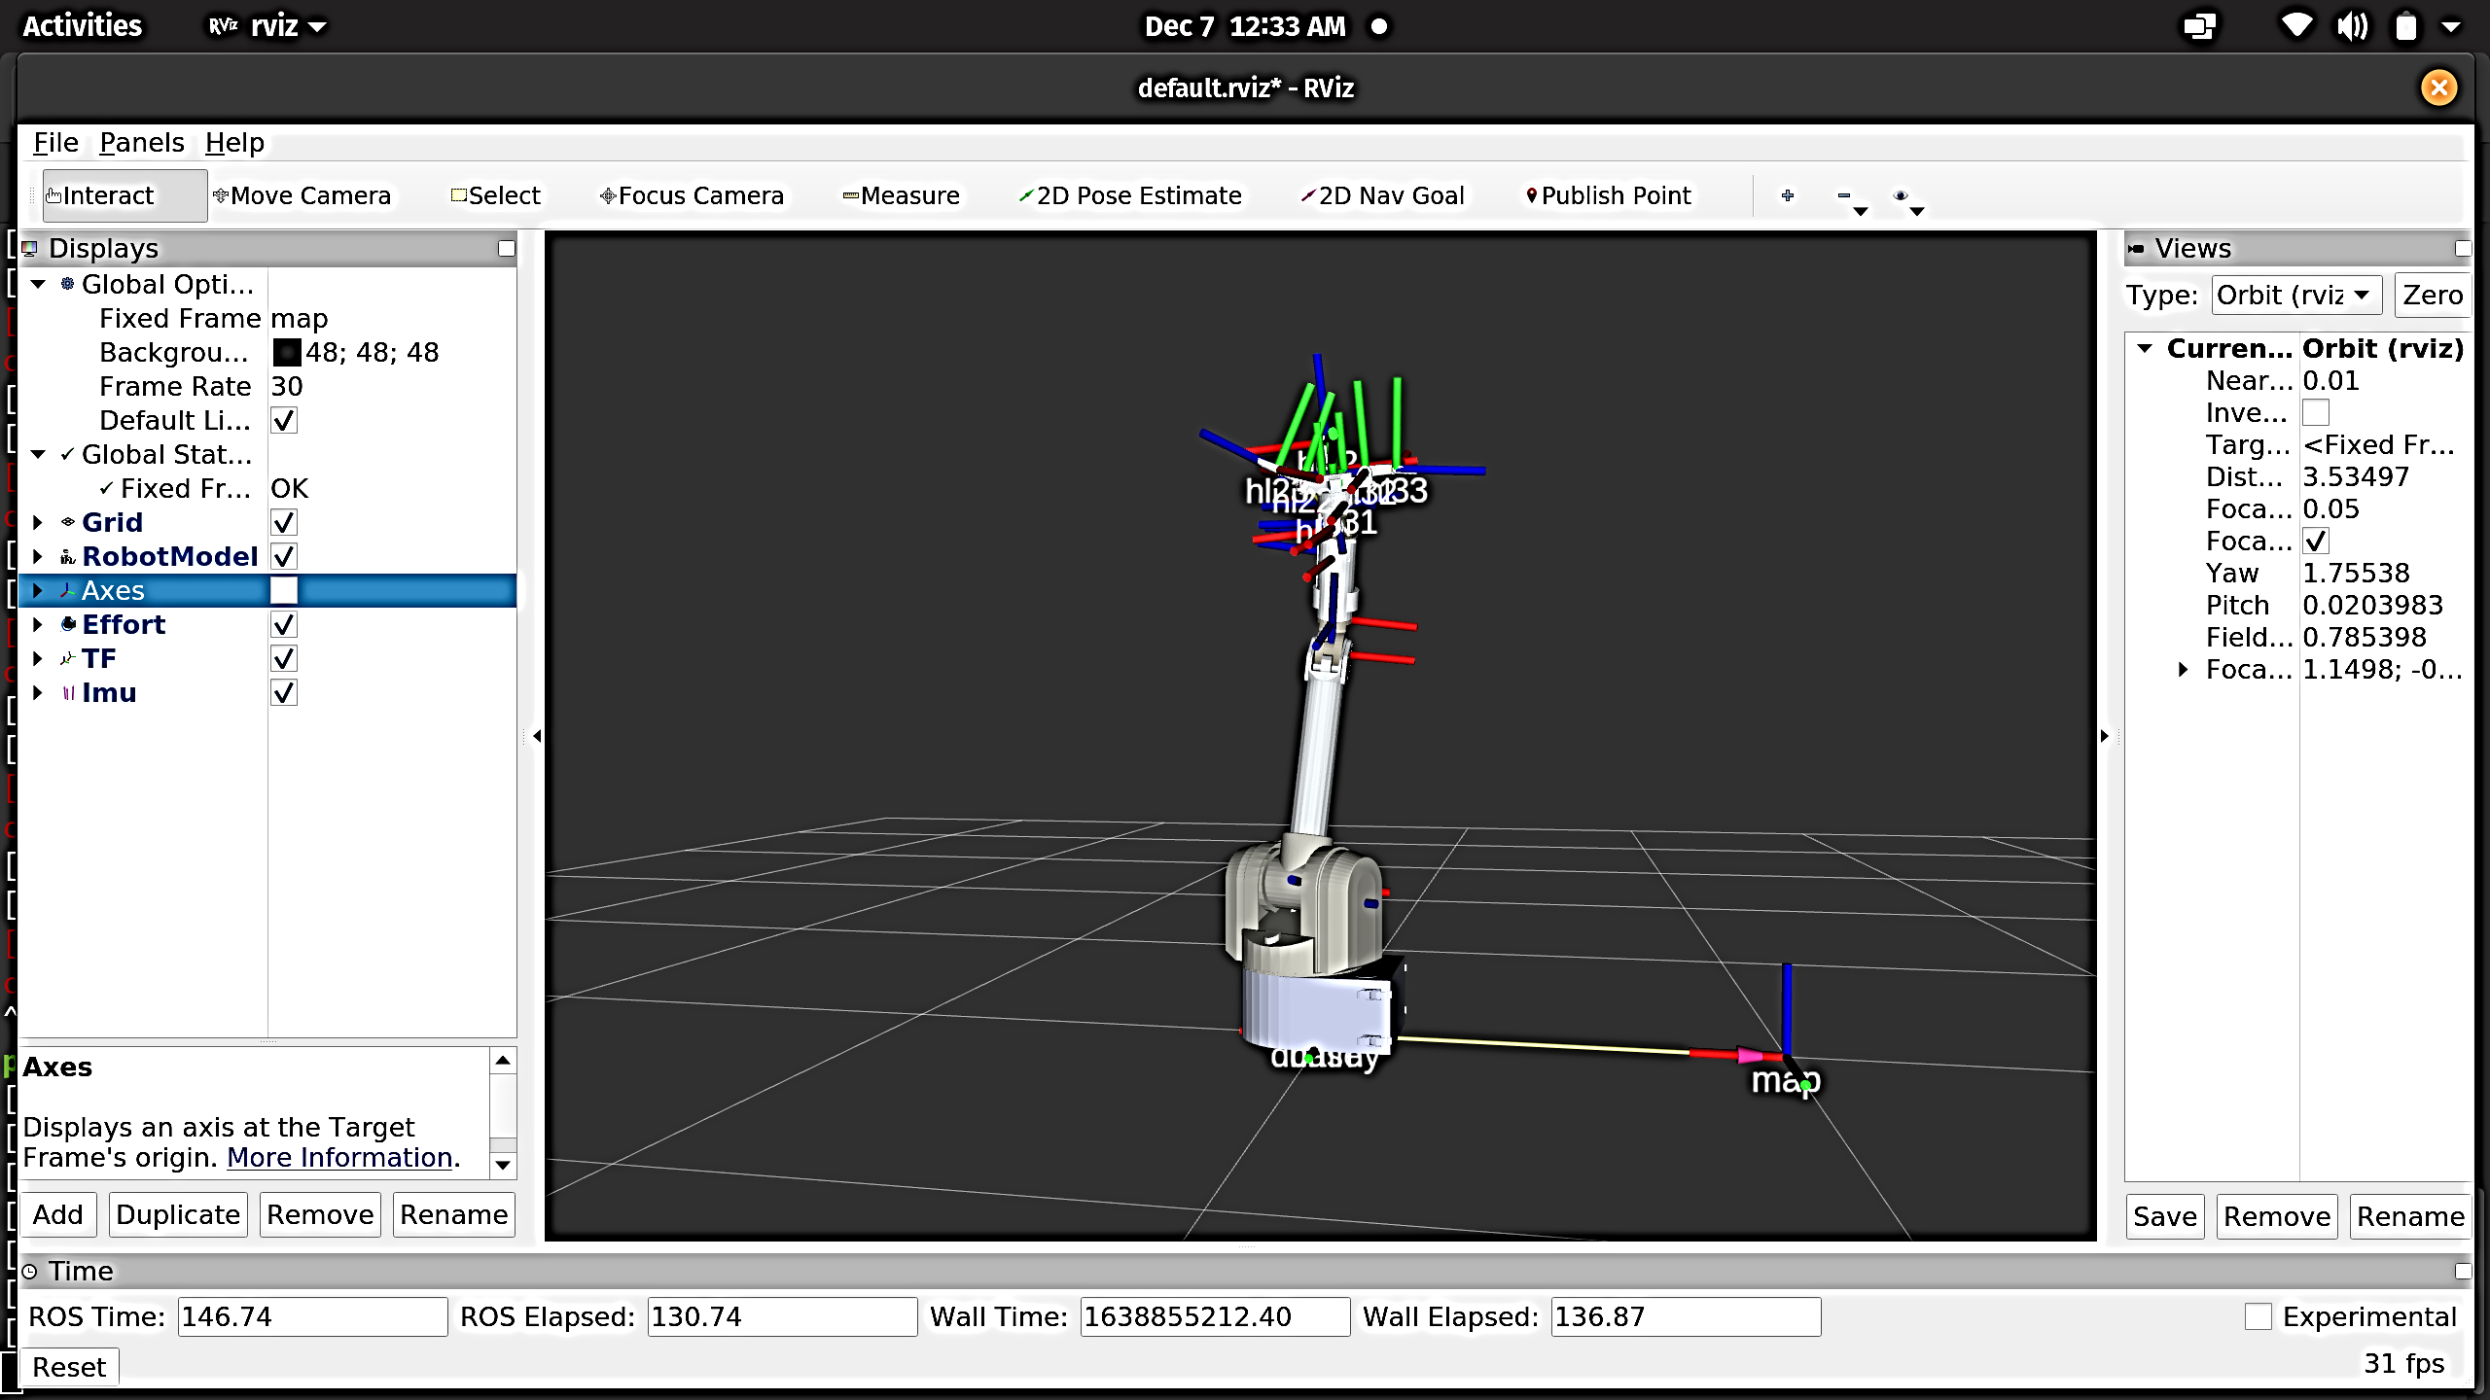
Visualization

Slide 12
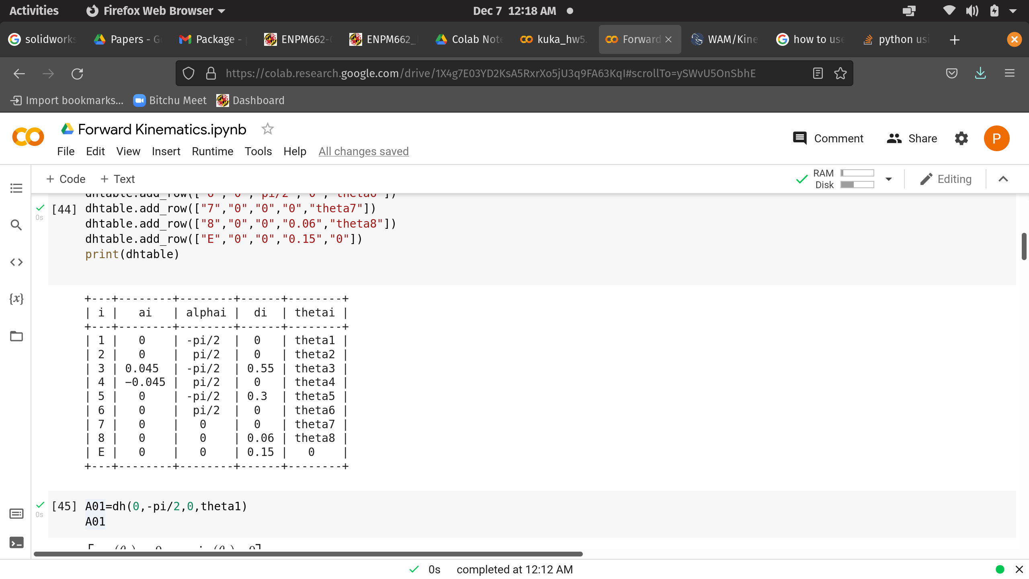
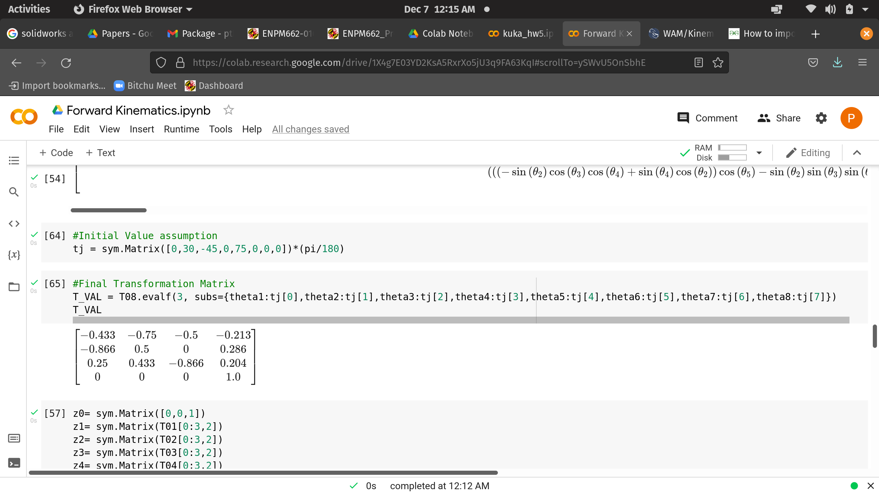
Calculations
DH Table:
Transformation Matrix :

Slide 13
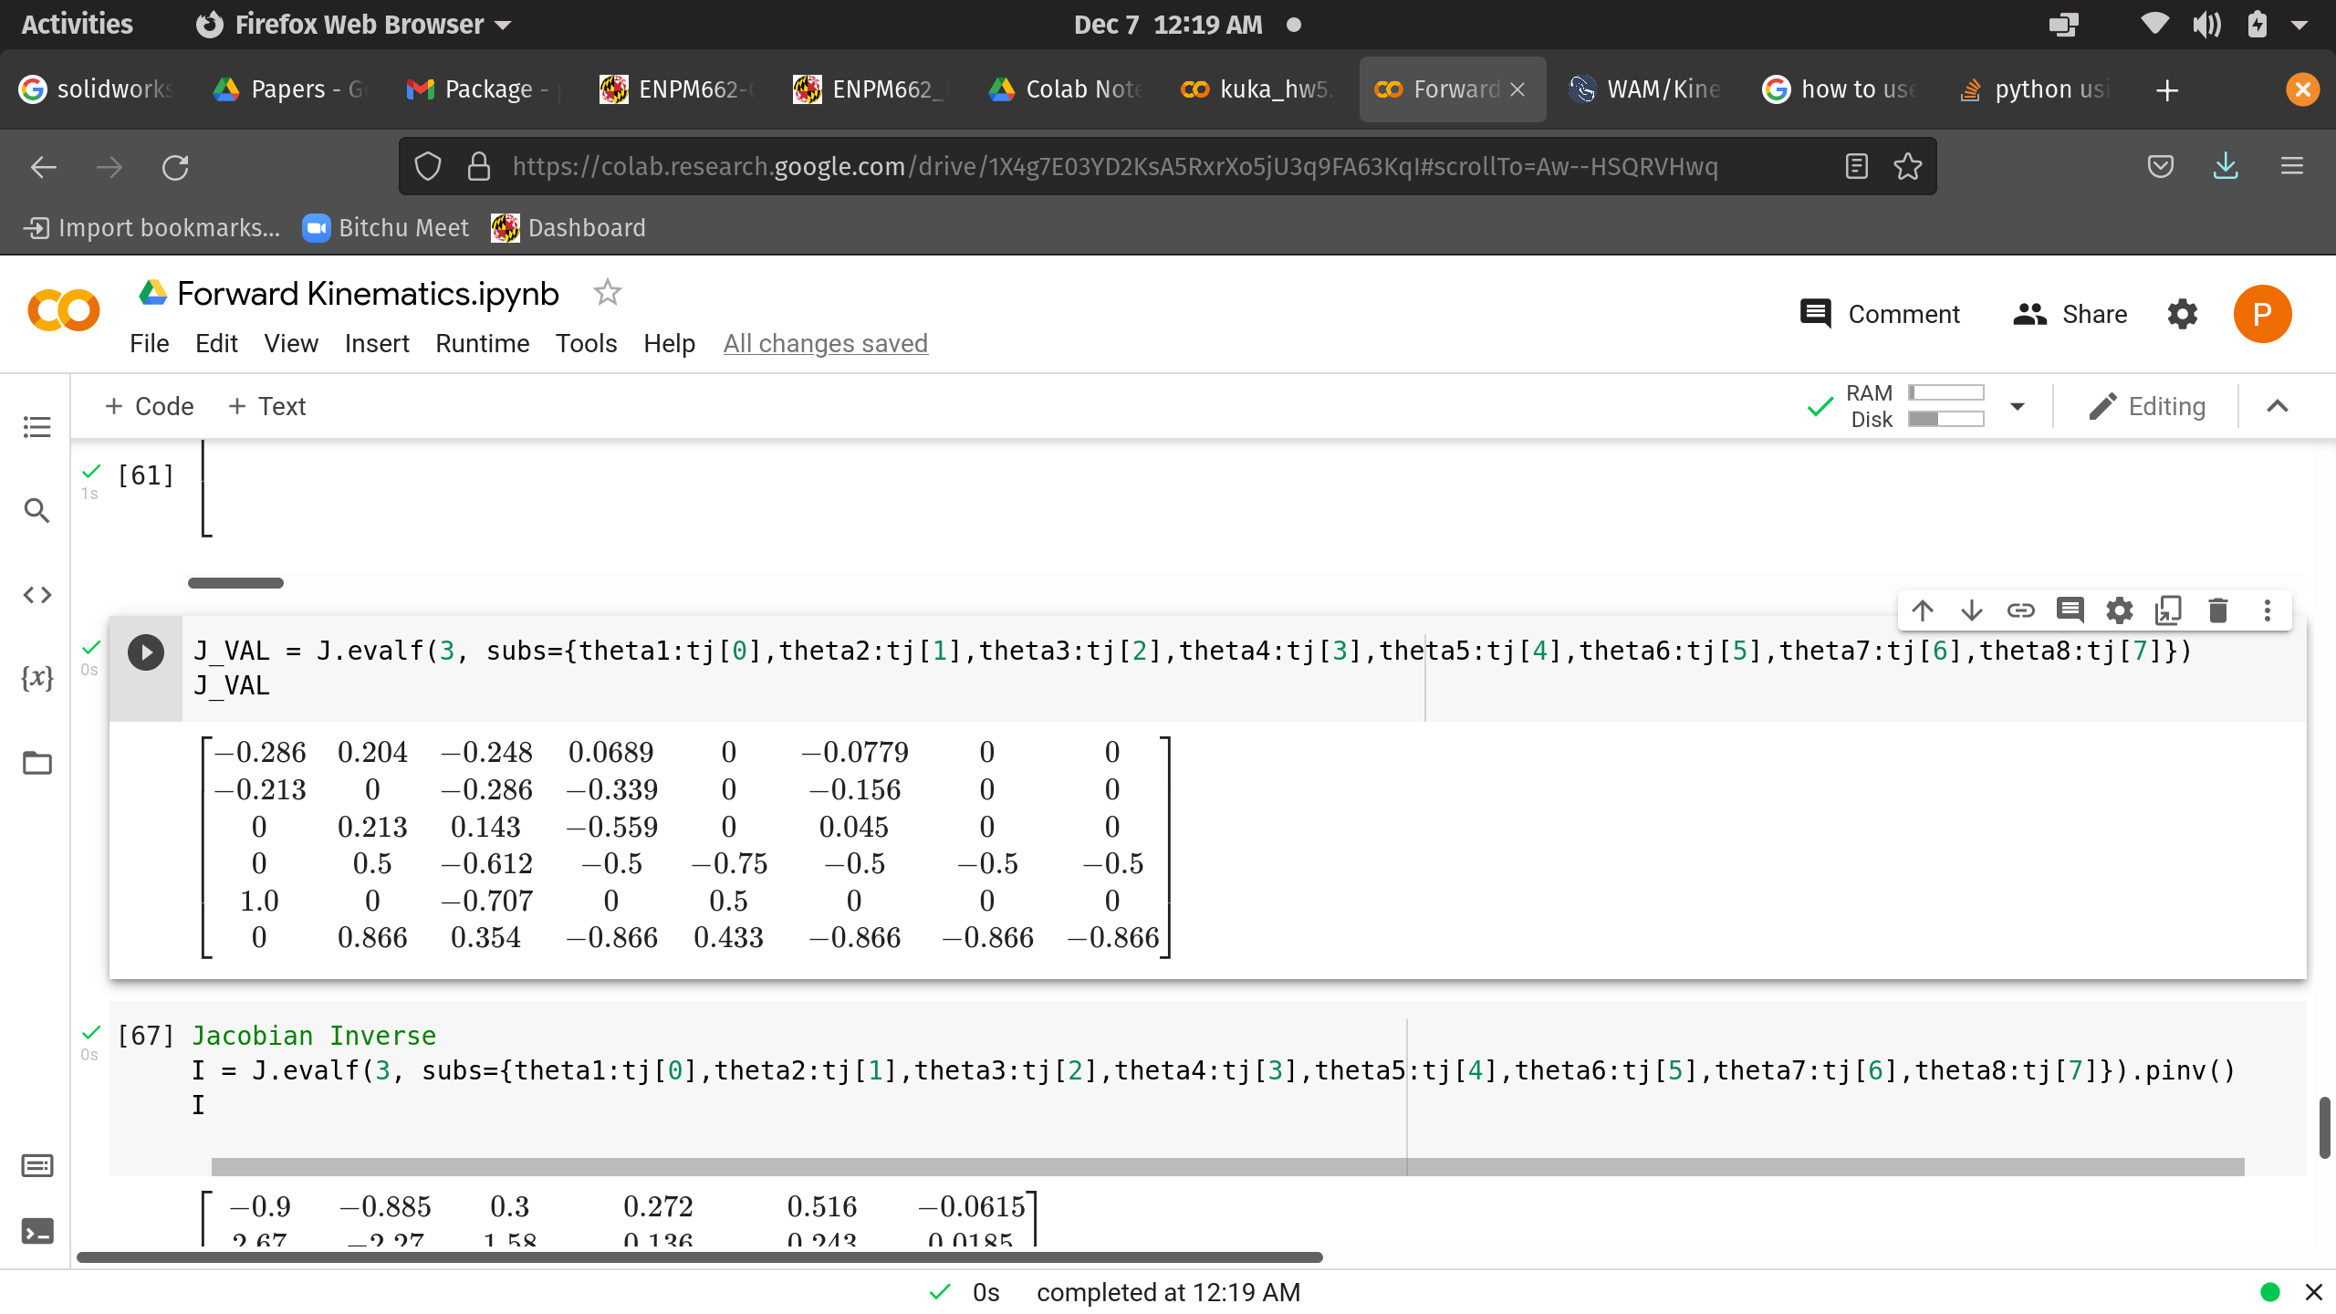
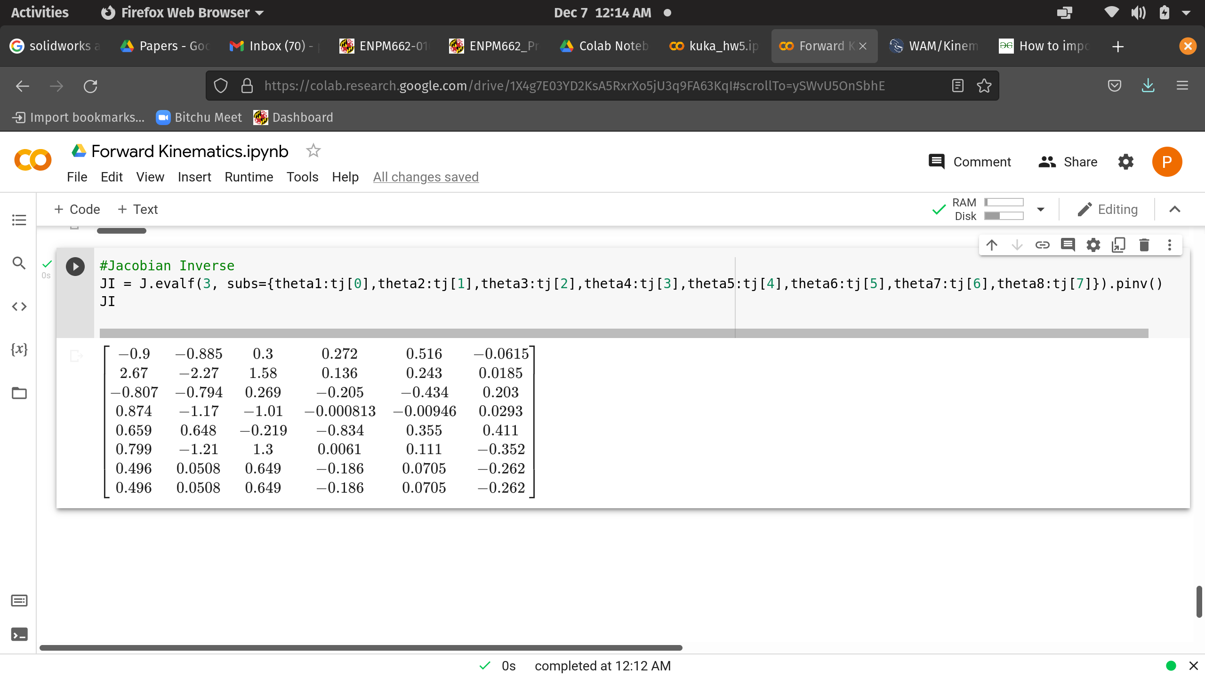
Calculations
Jacobian Matrix:
Jacobian Inverse:

Slide 14
Problems faced
CAD
PID
Teleop
The CAD Model took the longest of all the other steps, because of the orientation problem while spawning the model in gazebo.
Our specific model has 16 moving joints and all the joints required to be tuned in simultaneously.
The difficulty in this step was in the movement of the fingers and when one of the joints kept falling off to the ground and no input was able to move it back upwards

Slide 15
Problems faced
Controller
We tried numerous methods to implement effort controllers but we only got errors that the controller failed to load. So, we switched over to velocity controllers
Link masses and their moments
The masees of most links were inconsistent which made the robot to fall off to the ground every time while spawing the model
Maneuvering the bot
The bot was initially meant to be controlled by changing joint positions but we had to get around that by controlling the velocity values to the joints.

Slide 16
simulation
https://drive.google.com/drive/folders/1msxDopHkG6TL6kg3BVi8V42OveKyJZjA?usp=sharing

Slide 17
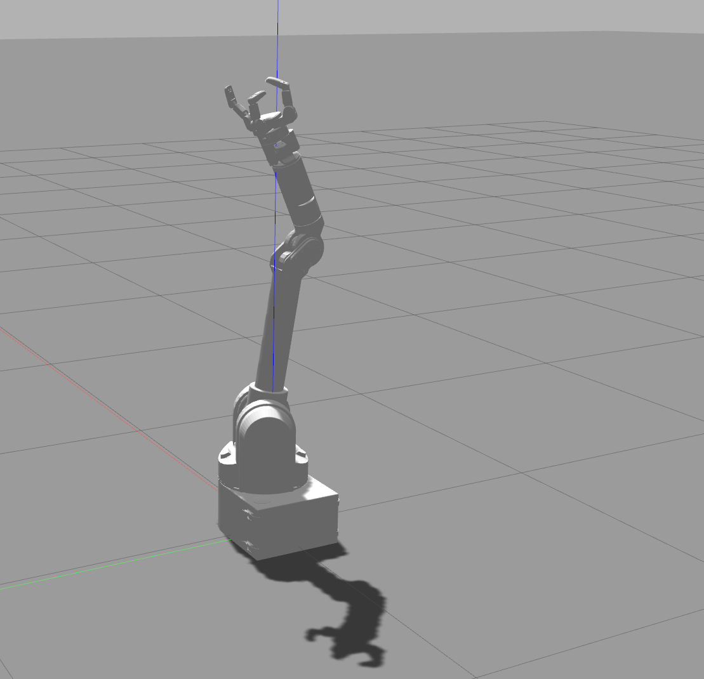
CONCLUSION
The project successfully serves the purpose of assisting the people with disability in mobility and the care giving industry, which can also be extended to help high risk health workers. The use of some advanced topics in robotics will allow the robot to be safely used in the same environment as humans.

Slide 18
References
Greg Chance, IMechE, Antonella Camilleri, Benjamin Winstone, Praminda Caleb-Solly, Sanja Dogramadzi-”An Assistive Robot to Support Dressing – Strategies for Planning and Error Handling “ -June 29, 2016.
C. Torras. Service robots for citizens of the future. European Review, 17-30, 2016
G. Canal, G. Alenyà and C. Torras. A taxonomy of preferences for physically assistive robots, 26th IEEE International Symposium on Robot and Human Interactive Communication, 2017, Lisbon, Portugal, pp. 292-29.
cdc.gov
brl.ac.uk/
chistera.eu
advanced.barrett.com
i-dress-project.iri.upc.edu/
www.iri.upc.edu/
who.int/

Slide 19
THANK YOU
Shelvin Pauly ​ Prasanna Raghavan
spauly@umd.edu pthiruku@gmail.com

